Slide 1
Oracle Explain Plans
A Step by Step Method to
Understanding Execution and Explain Plans
Presented By:
Eric Boyce

Slide 2
RBO vs CBO
• RBO – Rule Based Optimizer
• CBO – Cost Based Optimizer
• RBO desupported and replaced by CBO in 9.2. Availability of the RBO exists even in 11g, however, it’s use is unsupported.
• RBO used heuristics to determine access paths.
ex. Path 1 (Ranked Best): Single Row by Rowid
SELECT person_uid
FROM mst_person
WHERE ROWID = ‘AABjBBAARAAAAMGAAA’;
ex. Path 4: Single Row by Unique or Primary Key
SELECT *
FROM saturn.stvmajr
WHERE stvmajr_code=‘AADD’;
ex. Path 14 (Ranked Worst) Full Table Scan
SELECT * FROM mst_person;

Slide 3
Cost Based Optimizer
• The Cost Based Optimizer (CBO), when evaluating an access or data change request, creates a set of execution plan permutations. Each plan is assigned a cost based on the existing Oracle statistics and resource usage.
• The actual plan chosen by the Oracle CBO as being the ‘cheapest’. Can be viewed by querying V$SQL_PLAN.
• Cost is represented as the estimated resource usage for a given plan. A lower cost should equate to a more efficient execution plan when compared to a plan of higher cost.
• The max number of permutations prior to Oracle 10g was explicitly set using the OPTIMIZER_MAX_PERMUTATIONS init parameter. According to Oracle, setting the OPTIMIZER_FEATURES_ENABLE init parameter to any value higher than 9.0.0 sets the default to 2000 permutations. ^{*1}

Slide 4
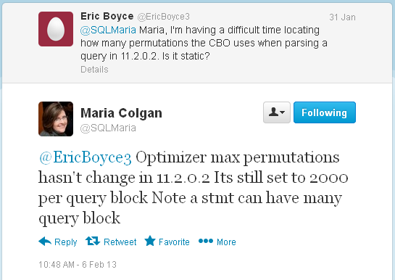
Cost Based Optimizer Cont.
• Sometimes white papers and books aren’t enough. After spending two hours searching for the number of CBO permutations in Oracle 11.2.0.2 I asked Maria Colgan, the product manager for the Oracle Optimizer:

Slide 5
What is an Explain Plan
• Using the EXPLAIN PLAN command, a developer or DBA can tabularize a query or DML execution plan without actually executing it. Useful when actual execution of a query or DML could be extremely time consuming.
• A set of steps stored in a plan table detailing Oracle’s method of performing operations necessary for the execution of a query or DML.
• Using the current optimizer environment (init parameters), available index statistics, available table statistics, etc. the EXPLAIN PLAN command will generate an execution plan representative of what it finds to be the optimal method of performing a user’s request at that current time.
i.e. A change in statistics, indices, init parameters, level of parallelism could potentially affect the actual execution plan that occurs when command is actually executed.

Slide 6
Optimizer Mode
• The initialization parameter OPTIMIZER_MODE specifies the default preferred behavior for choosing an optimization approach for the instance or session.
FIRST_ROWS_N
The optimizer uses a cost-based approach and optimizes with a goal of best response time to return the first N rows (where N = 1, 10, 100, 1000).
FIRST_ROWS
The optimizer uses a mix of costs and heuristics (rules) to find a best plan for fast delivery of the first few rows.
ALL_ROWS
The optimizer uses a cost-based approach for all SQL statements in the session and optimizes with a goal of best throughput (minimum resource use to complete the entire statement).
**ODS Instances use ALL_ROWS per the recommendations of Ellucian**

Slide 7
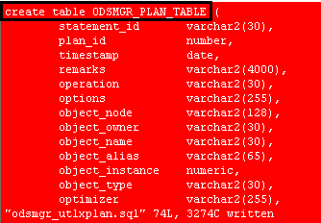
Creation of PLAN_TABLE
• Possible to create and populate your own custom plan table
• Run the utlxplan.sql script located in <ORACLE_HOME>/rdbms/admin
-This will create a plan table named PLAN_TABLE within the schema that runs the script.
-Custom name can be achieved by creating a copy of the script and modifying the create table statement.

Slide 8
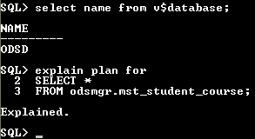
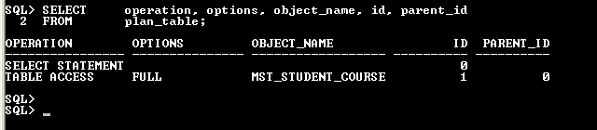
Explain Plan syntax
• Example without statement_id:
• SQL> EXPLAIN PLAN FOR
<Query or DML>;

Slide 9
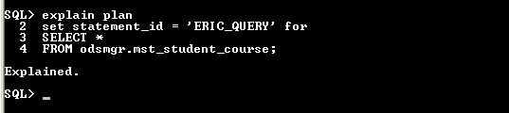
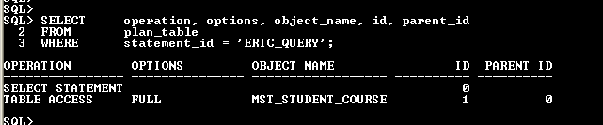
Example of Explain Plan
• Example with statement_id:
• SQL> EXPLAIN PLAN
SET STATEMENT_ID = ‘ERIC_QUERY’
FOR
<Query or DML>;
• If multiple people are generating explain plans this allows for specificity.

Slide 10
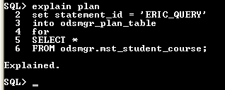

Example of Explain Plan
• SQL> EXPLAIN PLAN
SET STATEMENT_ID = ‘ERIC_QUERY’
INTO <personal plan table>
FOR
<Query or DML>;

Slide 11
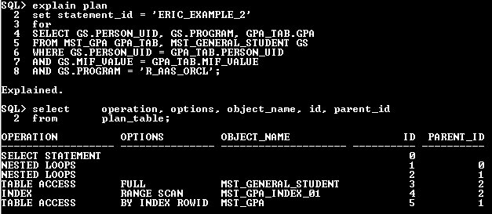
Building Tree Structure
• New query and explain plan for this example:
Two Tables: MST_GPA & MST_GENERAL_STUDENT
• Equijoins on PERSON_UID AND MIF_VALUE
• Additional predicate on MST_GENERAL_STUDENT.PROGRAM

Slide 12
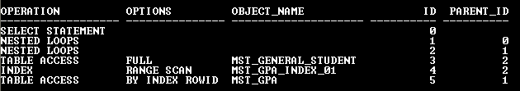
Building Tree Structure
1. Identify all operations, their IDs, and their parent IDs

Slide 13
Building Tree Structure
1. Identify all operations, their IDs, and their parent IDs

Slide 14
Building Tree Structure
2. Identify highest PARENT_IDs listed and which child IDs correspond to them

Slide 15
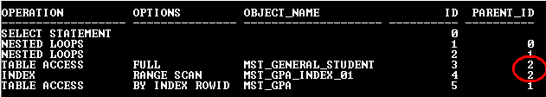
Building Tree Structure
2. Identify highest PARENT_IDs listed and which child IDs correspond to them

Slide 16
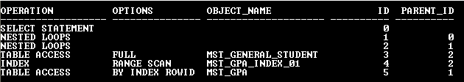
Building Tree Structure
3. Diagram relationship between PARENT_IDs and their child IDs

Slide 17
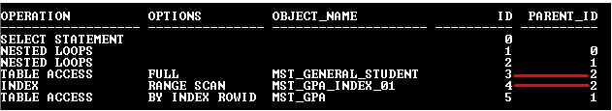
Building Tree Structure
3. Diagram relationship between PARENT_IDs and their child IDs

Slide 18
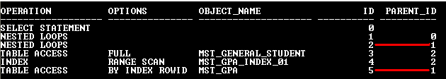
Building Tree Structure
3. Diagram relationship between PARENT_IDs and their child IDs

Slide 19
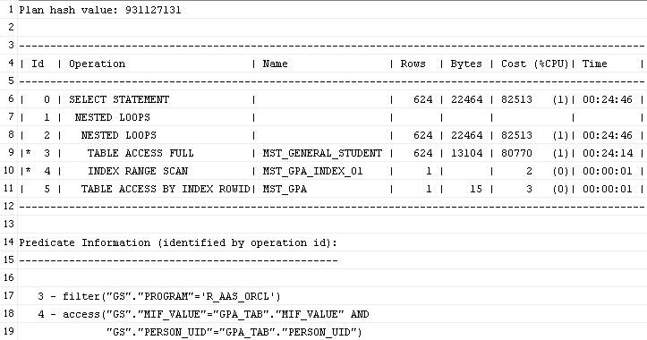
DBMS_XPLAN
• Package provided by Oracle to display explain plans in a variety of formats
• Consists of 5 table functions
• DISPLAY() is the only one pertinent function for this presentation:

Slide 20

Breaking it Down
• First Nested Loop
1st-
*Nested Loop –
Driver table (MST_GENERAL_STUDENT) is accessed using a full table scan on the filter predicate:
ROWIDs are retrieved from a probe table (MST_GPA) index (MST_GPA_INDEX_01) using the driver table’s result set access predicates.
**At this point we have the data needed from MST_GENERAL_STUDENT along with rowids (not data) retrieved from MST_GPA_INDEX_01**

Slide 21
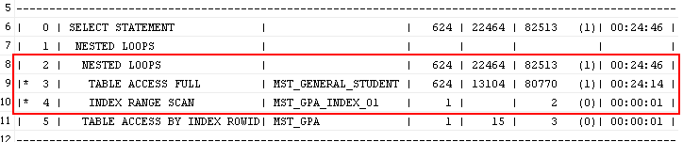
Breaking it Down cont.
• Second Nested Loop
-2nd-
Data from first Nested Loop now table-ized and contains PERSON_UID, PROGRAM, and the ROWIDS for MST_GPA where PROGRAM=‘R_AAS_ORCL’ and where MIF_VALUE and PERSON_UID are equal.
Using the above table-ized data, we can obtain the GPA column values by probing MST_GPA with the ROWIDS determined in the first NESTED LOOP.

Slide 22
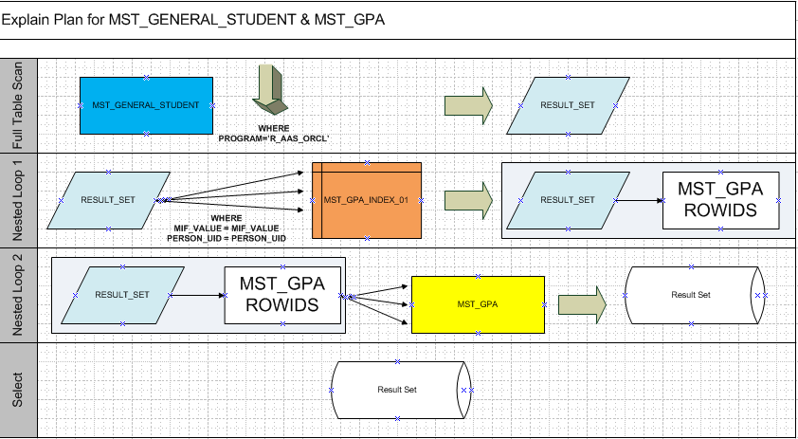
Graphical Representation

Slide 23
Questions?
• Questions?
• Next Time: Optimizer Join Methods Part I

Slide 24
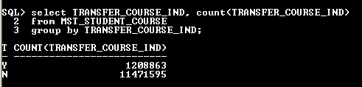
Histograms
• Histograms can be created manually or automatically.
• Useful for skewed data sets
• Example:
Two tables that are identical for all intents and purposes
ODSMGR.MST_STUDENT_COURSE IA_ADMIN.MST_STUDENT_COURSE_PRIME
Indexed Indexed
Stats Gathered Stats Gathered
Cardinality Cardinality
**Tables are identical save for the histogram to be placed on IA_ADMIN.MST_STUDENT_COURSE_PRIME.TRANSFER_COURSE_IND**

Slide 25
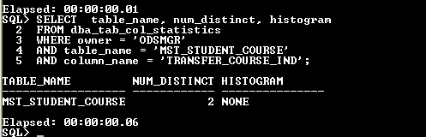
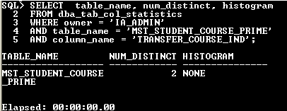
Histograms cont.
• We can see from the following queries that no histograms exist for the TRANSFER_COURSE_IND column on either table:

Slide 26
Explain Plan Considerations
• Ignores bind variables ^{*2} (No bind peeking)
• Takes into account table and index statistics
• Takes into account histograms
-Histograms are created when DBMS_STATS is run on a particular table.
• Takes into account level of parallelism for both tables and indices (more later).

Slide 27
References
^{*1} http://docs.oracle.com/cd/B28359_01/server.111/b28300/changes.htm#BABFJCFE
^{*2} http://tkyte.blogspot.co.uk/2007/04/when-explanation-doesn-sound-quite.html
http://www.oracle.com/ocom/groups/public/@otn/documents/webcontent/1354477.pdf

